Slide 1
Severe Acute Malnutrition

Slide 2
Severe acute Malnutrition
It is a lack of enough or sufficient nutrients in the body.
It can be under-nutrition or over-nutrition

Slide 3
cont..
Acute malnutrition- acute malnutrition is a form of undernutrition. It is caused by a decrease in food consumption and/or illness resulting in bilateral pitting edema and/or sudden weight loss.
It is classified into severe acute malnutrition(SAM) and moderate acute malnutrition (MAM) according to the degree of wasting and the presence of edema.

Slide 4
cont...
Severe acute malnutrition- is defined by the presence of bilateral pitting oedema or severe wasting (MUAC < 11.5 cm or a WFH < -3 z-score [WHO standards]) in children 6-59 months old.
A patient with sam is highly vulnerable and has a high mortality risk

Slide 5
Epidemiology
In 2020, a study conducted by UNICEF, WHO, and the world bank shows 144 million children under the age of 5(21.3%) across the world suffer from stunting and 47 million(6.6%) from wasting.
A study performed in ethiopia in 2016 showed that;
- 38% of children under 5 age were stunted or too short for their height and 18%
Stunted
- 10% were wasted or too thin for their height including 3% who were severely
- 24% of children under the age 5 were underweight or were too thin

Slide 6
Etiology
Primary-when the otherwise healthy individual’s needs for protein, energy, or both are not met by an adequate diet.
Secondary-result of disease state that may lead to sub optimal intake, inadequate nutrient absorption or use, and increased requirements because of nutrient loss or increased energy expenditure.

Slide 7
Precipitating factors
Lack of food
Inadequate breast feeding
Diarrhoea and malabsorption
Infection

Slide 8
Pathophysiology
Appetite loss, nutrient loss and malabsorption
Inadequate dietary intake
weight loss, growth faltering, lowered immunity
prone to infection and other disease

Slide 9
cont....
When a child’s intake is insufficient to meet daily needs:
Physiologic and metabolic changes take place in an orderly progression to conserve energy and prolong life.
This process is called reductive adaptation.

Slide 10
Cont…
Fat stores are mobilized to provide energy.
Later protein in muscle, skin, and the gastrointestinal tract is mobilized.
Energy Conservation

Slide 11
Cont…
Energy is conserved by
Reducing physical activity and growth,
Reducing basal metabolism and the functional reserve of organs and
Reducing inflammatory and immune responses.
These changes have important consequences

Slide 12
Consequence of reductive adaptation
Lethargy and irritability
Impaired thyroid function
Impaired cardiac function
Respiratory tract infection
Impaired hepatic synthetic function
Impaired glomerular and tubular function
Loss of skin integrity

Slide 13
Clinical manifestation
Weight loss
Lack of appetite(anorexia)
Tiredness and irritability
Temperature change
Loss of fat, muscle mass, and body tissue
Depression
Bilateral pitting edema
Anemia
Change in alertness

Slide 14
Complications
Poor appetite
Intractable vomiting
Convulsions
Lethargy
Unconsciousness
High fever (axillary temperature >39 C)
⁰

Slide 15
cont...
Lower respiratory tract infection
Dehydration
Persistent diarrhoea
Severe anaemia
Hypoglycaemia
Hypothermia (axillary temp. < 35⁰c)
Severe skin lesions

Slide 16
Kwashiorkor vs Marasmus
Kwashiorkor | Marasmus
It develops in children whose diets are deficient of protein. | It is due to deficiency of protein and calories.
It occurs in children between 6 month and 3 years of age | It is common in infants under one year of age.
Subcutaneous fat is preserved. | Subcutaneous fat is not preserved.
edema is present. | Oedema is absent.
Ribs are not very prominent. | Ribs become very prominent.
Lethargic. | Alert and irritable.
Muscle wasting mild or absent. | Severe muscle wasting.
Poor appetite. | Voracious feeder.
The person suffering from kwashiorkor needs adequate amount of protein | The person suffering from marasmus needs adequate amount of protein, fat and carbohydrate.

Slide 17
Diagnosis
Triage
Assess for bilateral pitting oedema
Measure MUAC or WFL
Conduct RUTF appetite test for children 6-59 month
Assess for recent weight loss or failure to gain weight and feeding in infants 0-6 month
Check for medical complications
Decide where to treat patients

Slide 18
Anthropometric Indicators of Nutritional Status
Weight for age
Weight for height
Height for age
MUAC

Slide 19
Cont…
% Weight for height = ((weight of patient) / (weight of a normal child of the same height))*100
% Height for age = ((height of patient) / (height of a normal child of the same age))*100
 | Weight for height (wasting) | Height for age (stunting)
Normal | >90 % | >95%
Mild | 80-90% | 90-95%
Moderate | 70-80% | 85-90%
Severe | <70% | <85%

Slide 20
Cont…
Children with SAM have very low weight-for-height/length <- 3SD,
mid-upper arm circumference <115 mm, or by the presence of nutritional edema.
Children with SAM with loss of appetite or any medical complication have complicated severe acute malnutrition and should be admitted for inpatient care.
Children who have a good appetite and no medical complications can be managed as out-patients.

Slide 21
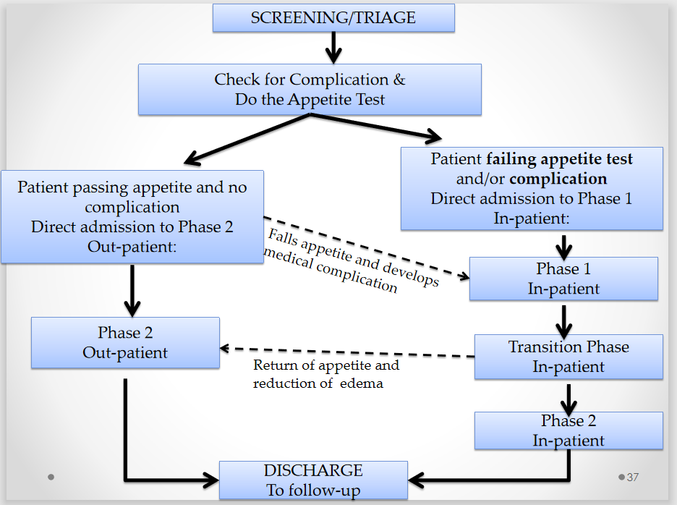

Slide 22
Admission procedure for children 6-59month
Triage
Antropometric measurement to confirm nutritional status
Conduct RUTF appetite test
Conduct medical assesment

Slide 23
Appetite test
Even though the definition and identification of SAM is by anthropometric measurements, it is mainly the metabolic malnutrition that causes death.
Often the only sign of severe metabolic malnutrition is a reduction in appetite.
The most important criterion to decide if a patient should be sent to in or out patient management is the appetite test.

Slide 24
cont...
How to do appetite test:
- Do the test in a separate quiet area
- explain to the mother/caregiver how the test will be done,
-The mother/caregiver should wash her hands,
- The mother sits comfortably with the child on her lap and offers therapeutic food,
- The child shouldn’t have taken any food for the last 2 hrs,
- The test usually takes a short time but may take up to one hr,
-The child must not be forced to take the food offered,
-When the child has finished, the amount taken is judged/ measured.

Slide 25
Treatment for OTP patients
10% sugar water solution to prevent hypoglycemia,
RUTF depending on the weight of the child,
Amoxicillin,
De-worming tabs,
Measles vaccine if patient is 9-59 month.

Slide 26
Treatment for SC patient
It’s separated into 3 phases
Stabilization phase
It’s aim is to repair cellular function, correct fluid and electrolyte imbalance, restore homeostasis.
Stabilized first by following 10 steps m/m
Lasts for 1-2 days
The feeding formula(f-75) is starter diet which promotes recovery of normal metabolic function and nutrition and electrolyte balance .

Slide 27
Cont…
Transition phase
The child moves to transition phase when there is
Atleast the beginning of loss of oedema
Return of appetite
Is alert and active

Slide 28
cont...
Lasts for 3-7 days
It is intended to ensure that the child is clinically stable and can tolerate an increased energy and protein intake
The only difference in this phase is the change in type of diet
- Gradual transition from starter diet(f-75) to catch up diet(f 100)
- Quantity of catch up diet (F 100) given is equal to the quantity of starter diet given in stabilization phase.

Slide 29
Con…
Rehabilitation phase
The child progress to rehabilitation phase when:
Has reasonable appetite finishes >90% of feed that is given without significant pause
Major reduction or loss of edema
No other medical complication
It’s aim is to promote rapid weight gain,stimulate emotional and phyiscal development and prepare the child to start normal feeding at home.

Slide 30
Cont…
Pushing ahead too quickly induce risks such as “refeeding syndrome.” It is a fatal shift in fluid and electrolyte that may occur in malnourished patient receiving artificially refeeding. It is characterized by fatigue, weakness, confusion, high BP, irregular heart beat and difficulty in breathing.

Slide 31
10 steps managment
10 step management | Stabilization Day 1-2 | Transition Day 3-7 | Rehabilitation weeks 2-6
1.Hypoglycemia
2.Hypothermia
3.Dehydration
4.Electrolyte imbalance
5.Infection
6.Micronutrient | no iron | with iron
7.Initiate feeding
8.Catch up growth
9.Sensory stimulation
10.Prepare for follow up

Slide 32
SC Admission Criteria for Infants 0-6 Months
Any grade of bilateral pitting edema (+, ++ or +++)
WFL < -3 z score
Recent weight loss or failure to gain weight
Ineffective feeding
Presence of any medical complications

Slide 33
Management of the Breastfed Infant 0-6 Months
Prioritize re-establishing effective exclusive breastfeeding.
Dietary treatment
The objective is to supplement the child’s breastfeeding with therapeutic milk while stimulating breast milk production.
The infant should be breastfed as frequently as possible. Between 30 minutes and 1 hour after a normal breastfeeding session, give maintenance amounts of therapeutic milk.
Give f-100-diluted to breastfed infants without bilateral pitting edema. Give F-75 to infants with bilateral pitting edema and change to f-100-diluted when the edema is resolved.
Never give full strength f-100 to infants 0-6 months old.

Slide 34
cont...
Promote and support the mother or caregiver to breastfeed.
Assess the physical and mental health status of mothers or caregivers and provide relevant treatment and support.
Routine medicines and supplements.
Broad-spectrum antibiotics.
Provide daily doses of iron syrup orally.

Slide 35
Discharge criteria
Successful re-lactation and effective breastfeeding has been achieved.
Gaining weight on exclusive breastfeeding (i.E., More than 5 g/kg/day for at least 3 successive days).
No bilateral pitting oedema.
Clinically well and alert.
Infant has been checked for immunization and other routine interventions.
Mothers or caregivers have been linked with community-based follow-up and support.

Slide 36
Prevention of malnutrition
Some of the prevention mechanisms are;
Breast feeding
Complementary feeding
Nutrition supplementation
Family planning

Slide 37
THANK YOU

